Slide 1
Core Messaging Patterns

Slide 2
Core Messaging Patterns
Pattern 1: Point-to-Point

Slide 3
What is Point-to-Point Messaging
Message sent from one sender to receiver
Straightforward, reliable way to send messages
Notes:
Definition
Point-to-point messaging is a communication pattern where a message is sent from one sender to one receiver. This ensures that each message is processed by exactly one consumer.
Purpose
It provides a straightforward, reliable way to ensure that messages are delivered and processed without duplication.

Slide 4

Key Components
Message Producer (Sender)
Message Queue
Message Consumer (Receiver)
Producer
Queue
Consumer
Notes:
Message Producer (Sender)
The component or service that creates and send messages.
Message Queue
A temporary storage area where messages are held until they are processed by a receiver.
Message Consumer (Receiver)
The component or service that retrieves and processes messages from the queue.

Slide 5
Benefits
Guaranteed Delivery
Simplicity
Decoupling
Load Balancing
Reliability
Flexibility
Control
Notes:
Guaranteed Delivery: Ensures that messages are delivered and processed exactly once by the intended consumer, reducing the risk of message loss.
Simplicity: The straightforward one-to-one communication model simplifies the design and implementation of messaging systems.
Decoupling: Separates the producers and consumer, allowing them to operate independently. Changes to one do not necessary impact the other.
Load Balancing: Distributes the load among multiple consumers. Each consumer can process messages independently, improving the system’s overall throughput and scalability.
Reliability: Provides mechanisms such as acknowledgements and retries to ensure messages are successfully processed.
Flexibility: Suitable for a variety of use cases, including task distribution, job scheduling, and order processing.
Control: The send has more control over message flow and can manage priorities and ordering more effectively.

Slide 6
Drawbacks
Scalability Issues
Single Point of Failure
Resource Utilization
Message Ordering
Latency
Overhead
Error Handling Complexity
Notes:
Scalability Issues: May face challenges when scaling to a large number of producers or consumers, especially if the message broker or queue becomes a bottleneck.
Single Point of Failure: If the message broker or queue fails, messages may be lost or delayed, impacting the overall system reliability.
Resource Utilization: Requires careful management of resources, such as memory and storage, to handle the message queue effectively.
Message Ordering: Ensuring message ordering can be complex, especially with multiple consumers processing message concurrently.
Latency: Introducing a queue can add latency to the system, as messaging needs to be queued, retrieved, and processed.
Overhead: Managing and maintaining the messaging infrastructure adds operational overhead.
Complexity in Error Handling: Implementing robus error handling and retry mechanisms can be complex and requires careful consideration.

Slide 7
Use Cases
Job Queue
Task Scheduling
Order Processing
Notes:
Job Queue
Distributing jobs to available workers for execution.
Task Scheduling
Assigning tasks to workers in a distributed system.
Order Processing
Ensuring each order is processed by a single service instance.

Slide 8
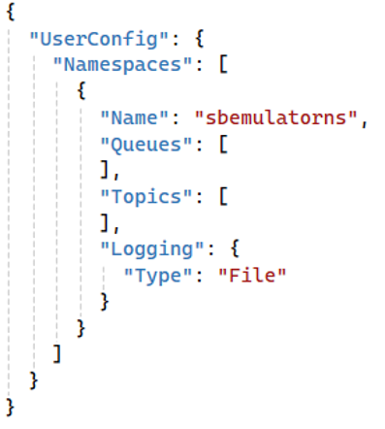
Demonstration
Create Namespace
Notes:
Create an Azure Service Bus Namespace
Typically, we would log into the Azure portal and create an Azure Service Bus namespace; but for this workshop, we are using the local emulator.

Slide 9
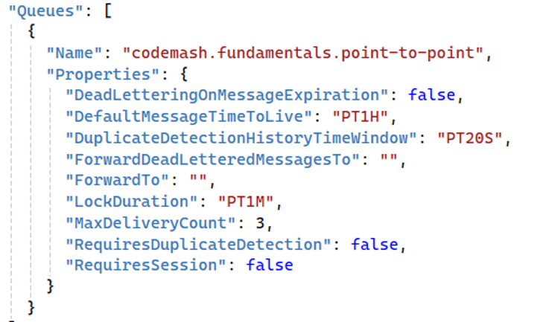
Demonstration
Create Namespace
Create a Queue
Notes:
Create an Azure Service Bus Namespace
Typically, we would log into the Azure portal and create an Azure Service Bus namespace; but for this workshop, we are using the local emulator.

Slide 10
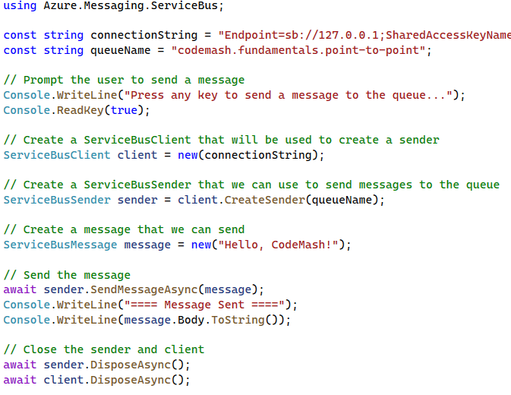
Demonstration
Create Namespace
Create a Queue
Create a Message Producer
Notes:
Create a Message Producer
Use the Azure SDK to send a message to the codemash.fundamentals.point-to-point queue.

Slide 11
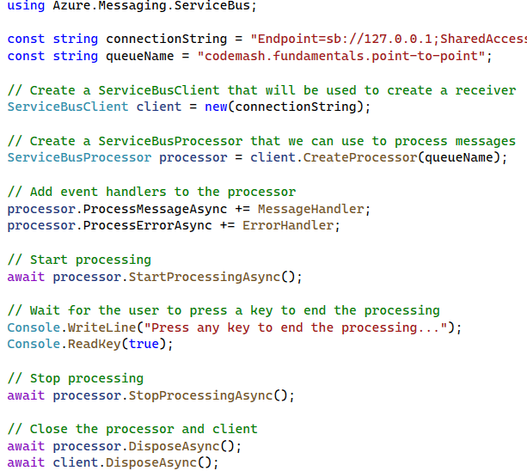
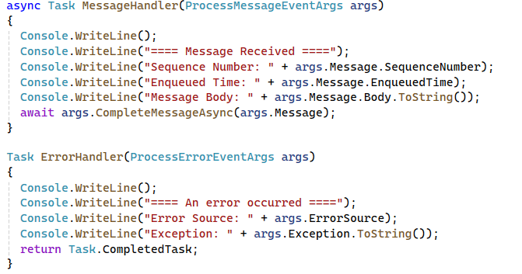
Demonstration
Create Namespace
Create a Queue
Create a Message Producer
Create a Message Consumer
Notes:
Create a Message Consumer
Use the Azure SDK to receive and process messages from the codemash.fundamentals.point-to-point queue.

Slide 12
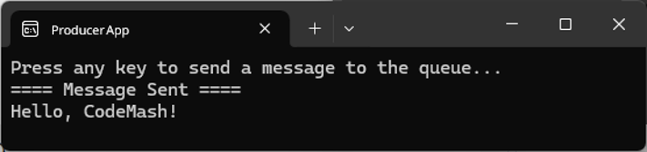
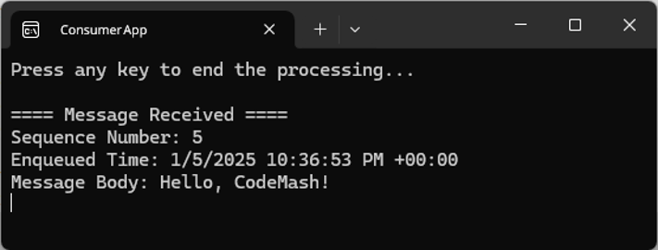
Demonstration
Create Namespace
Create a Queue
Create a Message Producer
Create a Message Consumer
Run the Demo
Notes:
Run the Demo
Execute the producer code to send a message.
Execute the consumer code to receive and process the message.
Observer the message flow from the producer to the consumer.

Slide 13
Key Points to Remember
Ensures one consumer processes messages.
Suitable for tasks that require guaranteed delivery to a single receiver.
Helps in decoupling producers and consumers, allowing them to operate independently.

Slide 14
Core Messaging Patterns
Pattern 2: Publish/Subscribe

Slide 15
What is Pub/Sub Messaging?
Messages published to a topic for multiple subscribers
Enables scalable and flexible communication
Notes:
Definition
Publish/Subscribe (Pub/Sub) messaging is a pattern where message are published to a topic and multiple subscribers receive the message. This allows one-to-many communication.
Purpose
It enable scalable and flexible communication, allowing multiple subscribes to receive the same message simultaneously.

Slide 16
Pub/Sub Key Components & Flow
Message Broker
Publisher
Topic
Subscriptions
Subscribers
Notes:
Message Publisher
The component or service that sends messages to a topic.
Topic
An intermediary channel where messages are published and made available to subscribers.
Message Subscribers
Components or services that subscribe to the topic and receive messages.
Message Broker
An optional intermediary that manages the topic and ensures messages are delivered to all subscribers.

Slide 17
Benefits
Decoupling
Multiple Consumers
Scalability & Flexibility
Notes:
Decouples message producers from consumers.
Supports multiple consumers for the same message.
Enhances scalability and flexibility in message delivery.

Slide 18
Drawbacks
Complexity
Notes:
Complexity in Message Management
Managing message delivery guarantees and ensuring messages are delivered to all subscribers can be complex.
Handling message ordering and duplicates across multiple subscribers adds additional complexity.

Slide 19
Drawbacks
Complexity
Scalability
Notes:
Scalability Challenges
As the number of subscribers grows, the load on the message broker can incr4ease, potentially impacting performance.
Ensuring timely delivery of messages to all subscribers can become more challenging with a high volume of messages.

Slide 20
Drawbacks
Complexity
Scalability
Subscriber Dependency
Notes:
Subscriber Dependency
As the number of subscribers grows, the load on the message broker can increase, potentially impacting performance.
Ensuring timely delivery of message to all subscribers can become more challenging with a high volume of messages.

Slide 21
Drawbacks
Complexity
Scalability
Subscriber Dependency
Resource Utilization
Notes:
Resource Utilization
Maintaining multiple subscriptions and handling message delivery can consumer significant system resources.
Ensuring the message broker has sufficient resources to handle peak loads is essential.

Slide 22
Drawbacks
Complexity
Scalability
Subscriber Dependency
Resource Utilization
Latency
Notes:
Latency
Message delivery to multiple subscribers can introduce latency, especially if the broker needs to handle a large number of messages or subscribers.
Real-time processing requirements may be impacted by the delay in message dissemination.

Slide 23
Drawbacks
Complexity
Scalability
Subscriber Dependency
Resource Utilization
Latency
Error Handling
Notes:
Error Handling
Detecting and handling errors across multiple subscribers can be challenging.
Implementing retry mechanisms and ensuring message integrity requires additional effort.

Slide 24
Use Cases
Broadcasting Events
Real-Time Data Feeds
Alert Systems
Notes:
Broadcasting Events
Notifying multiple services or components about an event, such as a user action or system change.
Real-Time Data Feeds
Distributing real-time data to multiple consumers, such as stock market updates or live sports scores.
Alert Systems
Sending alerts to multiple subscribers like monitoring systems or user devices.

Slide 25
Demonstration
Create Namespace

Slide 26
Demonstration
Create Namespace
Create a Topic

Slide 27
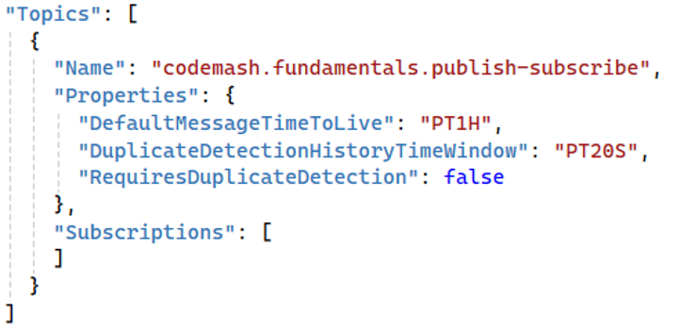
Demonstration
Create Namespace
Create a Topic

Slide 28
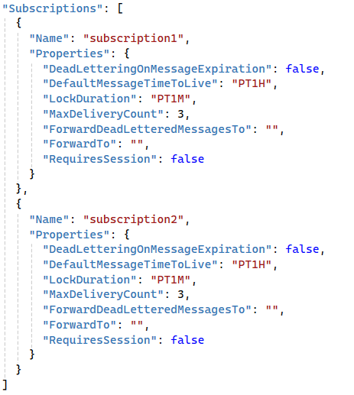
Demonstration
Create Namespace
Create a Topic
Create Subscriptions

Slide 29
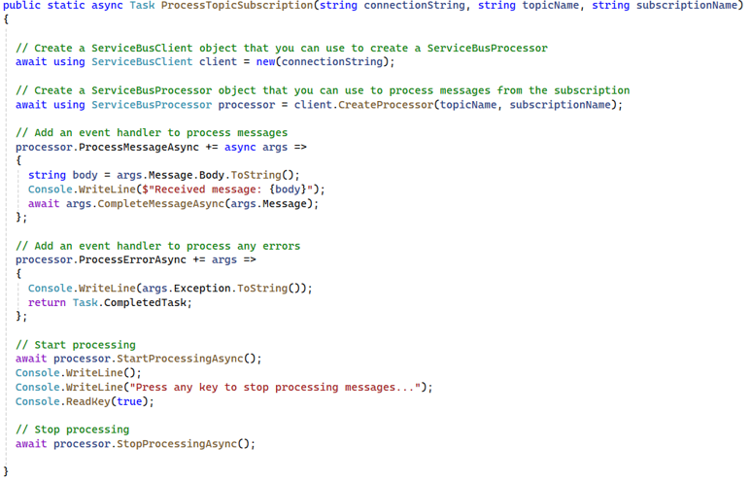
Demonstration
Create Namespace
Create a Topic
Create Subscriptions
Create Message Publisher
Create a Subscriber Helper

Slide 30
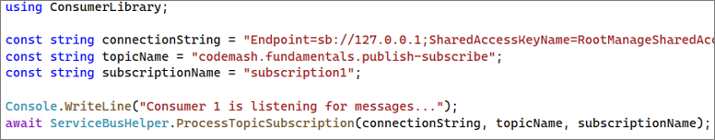
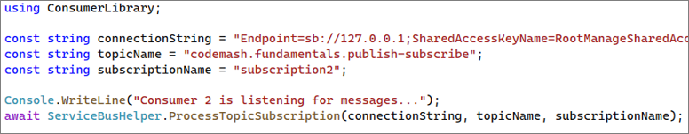
Demonstration
Create Namespace
Consumer 1
Create a Topic
Create Subscriptions
Create Message Publisher
Create a Subscriber Helper
Consumer 2
Create Message Subscribers

Slide 31
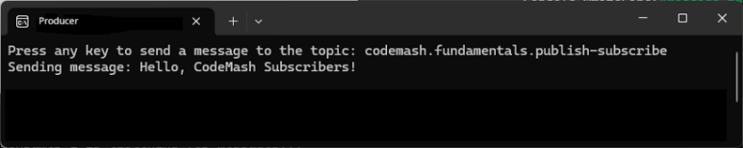
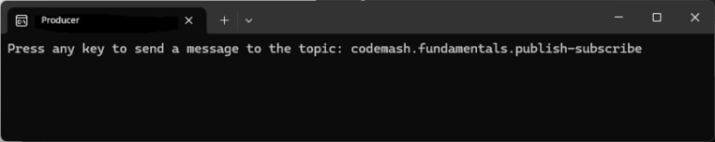
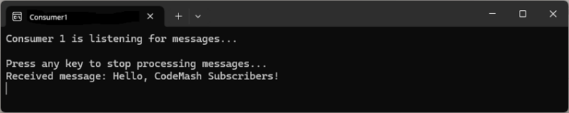
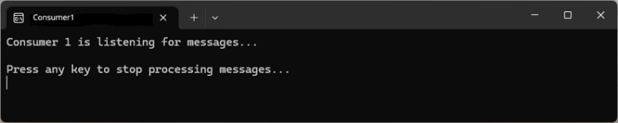
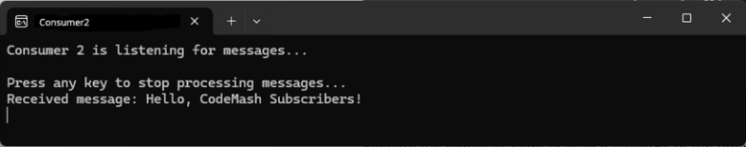
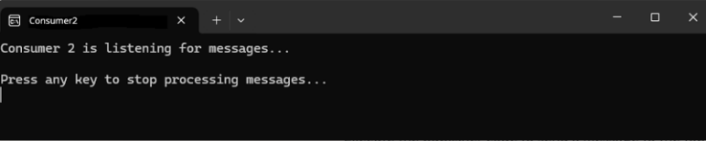
Demonstration
Create Namespace
Create a Topic
Create Subscriptions
Create Message Publisher
Create a Subscriber Helper
Create Message Subscribers
Run the Demo

Slide 32
Key Points to Remember
Supports one-to-many message delivery.
Useful for broadcasting vents or data to multiple consumers.
Decouples publishers and subscribers, enhancing system flexibility.

Slide 33
Core Messaging Patterns
Pattern 3: Competing Consumers

Slide 34
What are Competing Consumers?
Multiple consumers read and process queue
Allows multiple consumers to process messages concurrently
Notes:
Definition
Competing Consumers is a messaging pattern where multiple consumers read and process messages from the same queue. This helps distribute the workload and ensures scalability.
Purpose
It allows multiple consumers to process messages concurrently, improving system throughput and reliability.

Slide 35
Key Components & Flow
Message Broker
Producer
Message Queue
Competing Consumers
Notes:
Message Publisher (Sender)
The component or service that creates and sends messages to the queue.
Message Queue
A temporary storage area where messages are held until processed by consumers.
Competing Consumers (Multiple Consumers)
Multiple components or services that read and process message from the queue.
Message Broker
An optional intermediary that manages the queue, ensuring messages are delivered to available consumers.

Slide 36
Benefits
Scalability
Load Balancing
Fault Tolerance
Notes:
Scalability: Increases system throughput by processing multiple message simultaneously.
Load Balancing: Distributes the workload among multiple consumers, preventing bottlenecks.
Fault Tolerance: If one consumer fails can continue processing messages, enhancing reliability.

Slide 37
Drawbacks
Messaging Ordering
Complexity in Coordination
Resource Contention
Notes:
Message Ordering: Ensuring the order of message processing can be challenging when multiple consumers are involved.
Complexity In Coordination: Managing state and coordination between multiple consumers can add complexity.
Resource Contention: Multiple consumers may contend for resources, requiring careful management of resource allocation.

Slide 38
Drawbacks
Task Processing
Data Processing
Order Processing
Notes:
Task Processing
Distributing tasks among multiple workers to balance the load.
Data Processing
Parallel processing of large data sets to improve processing speed.
Data Processing
Handling incoming orders by multiple processing units to ensure timely execution.

Slide 39
Demonstration
Create Namespace

Slide 40
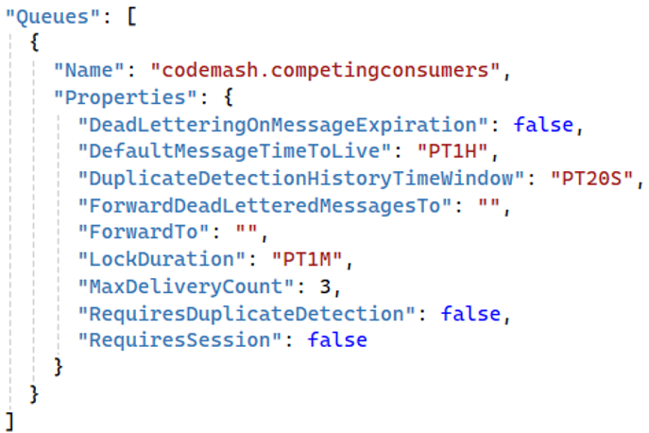
Demonstration
Create Namespace
Create the Message Queue

Slide 41
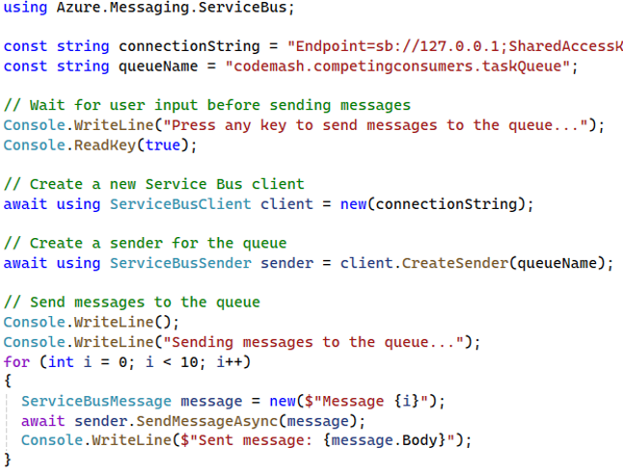
Demonstration
Create Namespace
Create the Message Queue
Create a Message Producer

Slide 42
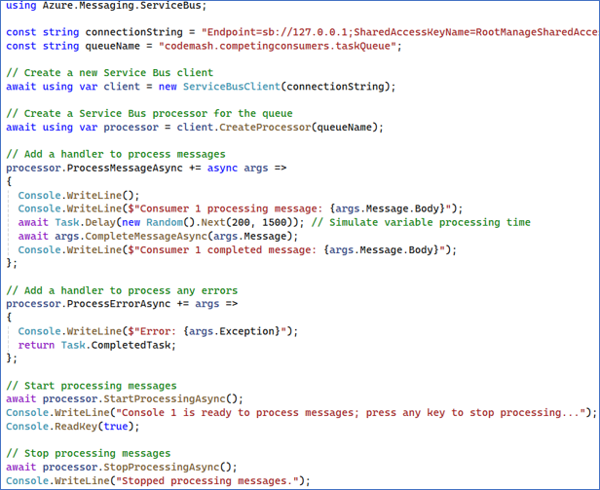

Demonstration
Create Namespace
Create the Message Queue
Create a Message Producer
Create Competing Consumers

Slide 43
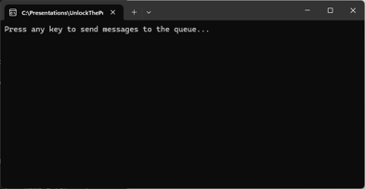
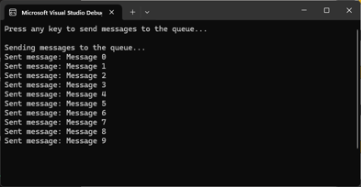
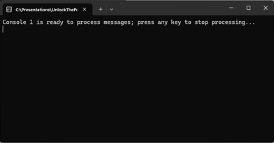
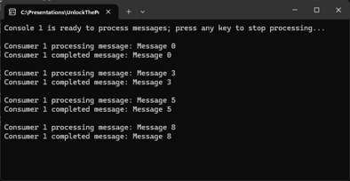
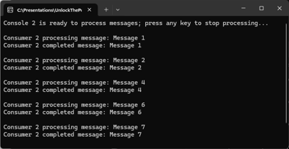
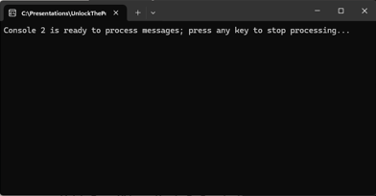
Demonstration
Create Namespace
Create the Message Queue
Create a Message Producer
Create Competing Consumers
Create Competing Consumers

Slide 44
Key Points to Remember
Supports concurrent message processing by multiple consumers.
Enhances system scalability, throughput, and reliability.
Effective for load balancing and fault tolerance.

Slide 45
Core Messaging Patterns
Request / Reply

Slide 46
What is Request/Reply Messaging?
Requester waits for a reply message
Enables synchronous communication
Notes:
Definition
Request/Reply messaging is a pattern where a sender sends a request message to a receiver and waits for a reply message. This allows for two-way communication between services or components.
Purpose
It enables synchronous communication where the sender expects a response to its request, often used in scenarios where confirmation or additional data is needed.

Slide 47
Key Components & Flow
Request Queue
Requestor
(Client)
Response Queue
Responder
(Sever)
Message Broker
Notes:
Requestor (Client): The component or service that sends a request message and waits for a reply.
Responder (Server): The component or service that receives the request message, processes it, and sends a reply message.
Message Broker: (Optional) An intermediary that routes messages between the requester and responder, ensuring reliable delivery.

Slide 48
Benefits
Synchronous Communication
Simplified Workflows
Reliability
Control and Coordination
Decoupling
Notes:
Synchronous Communication: Enables real-time interaction between services, where the requester gets an immediate response.
Simplified Workflows: Straightforward to understand and implement, as it follows a direct request-response cycle. Ideal for tasks like querying, data retrieval, and service invocation.
Reliability: Ensures that the requester gets a response, enhancing the reliability of the communication process. Can include error handling and retries to ensure successful message delivery.
Control and Coordination: Allows tight control and coordination between the requester and responder. Facilitates better management of state and session-based interactions.
Decoupling: While enabling synchronous communication, it still decouples the requester and responder, allowing them to evolve independently.

Slide 49
Drawbacks
Scalability
Latency
Resource Utilization
Complexity in Error Handling
Single Point of Failure
Notes:
Scalability Issues: Synchronous nature can lead to bottlenecks, especially under high load, as the requester waits for a response. Difficult to scale when there are many simultaneous requests.
Latency: Introduces latency as the requester has to wait for the responder to process the request and send a response. Not suitable for real-time or low-latency applications.
Resource Utilization: Ties up resources on both the requester and responder sides during the request-response cycle. Can lead to inefficient resource utilization if requests are long-running.
Complexity in Error Handling: Requires robust error handling mechanisms to manage timeouts, retries, and failed requests. More complex to implement reliable messaging guarantees compared to asynchronous patterns.
Single Point of Failure: The responder can become a single point of failure. If it goes down, requesters cannot get responses. Ensuring high availability and fault tolerance becomes crucial.

Slide 50
Use Cases
Service Invocation
Data Retrieval
Status Updates
Notes:
Service Invocation
Calling a service and waiting for a response, such as invoking a web service.
Data Retrieval
Requesting specific information from another service or component and receiving the required data.
Status Updates
Sending a request for the status of a process and receiving a status update in return.

Slide 51
Demonstration
Create Namespace

Slide 52
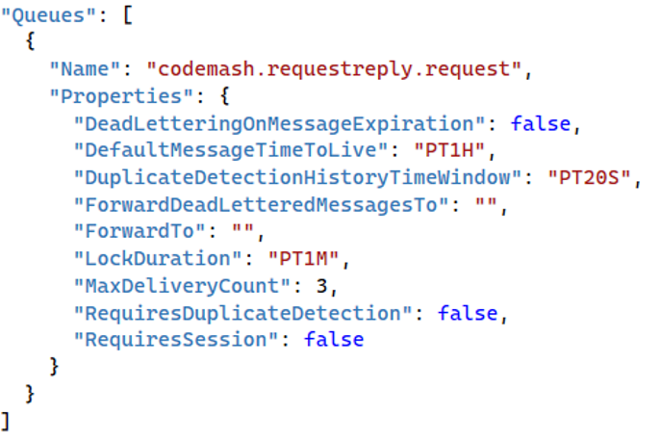
Demonstration
Create Namespace
Create the Request Queue

Slide 53
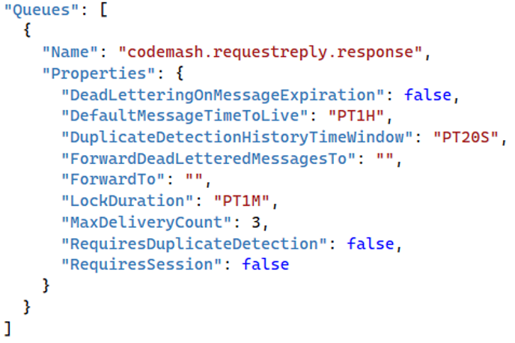
Demonstration
Create Namespace
Create the Request Queue
Create the Response Queue

Slide 54
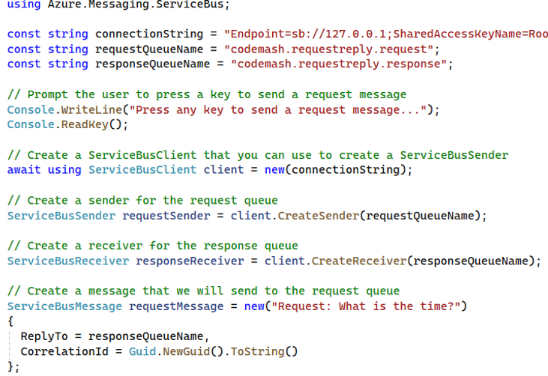
Demonstration
Create Namespace
Create the Request Queue
Create the Response Queue
Create the Requestor

Slide 55
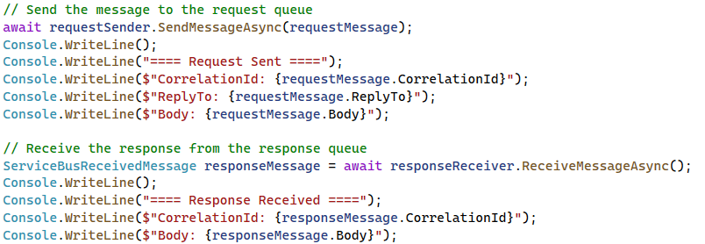
Demonstration
Create Namespace
Create the Request Queue
Create the Response Queue
Create the Requestor

Slide 56
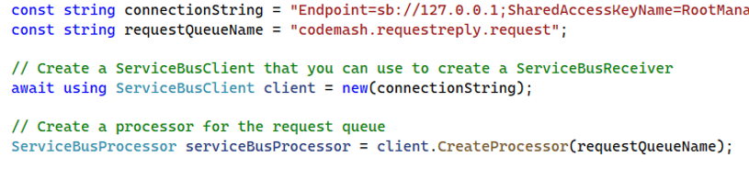
Demonstration
Create Namespace
Create the Request Queue
Create the Response Queue
Create the Requestor
Create the Responder

Slide 57
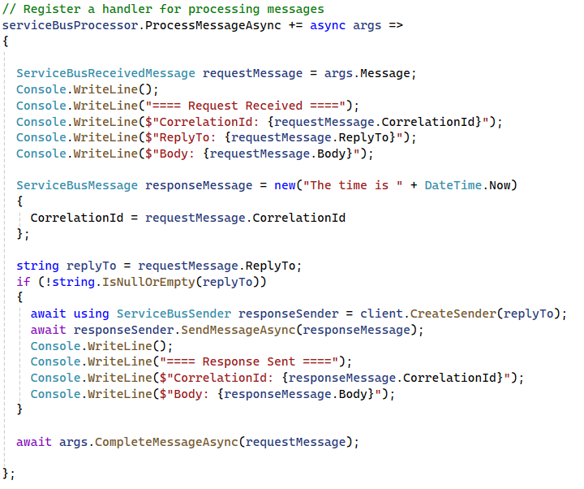
Demonstration
Create Namespace
Create the Request Queue
Create the Response Queue
Create the Requestor
Create the Responder

Slide 58
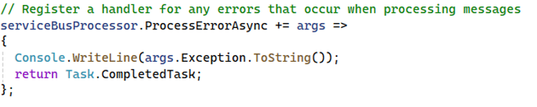
Demonstration
Create Namespace
Create the Request Queue
Create the Response Queue
Create the Requestor
Create the Responder

Slide 59
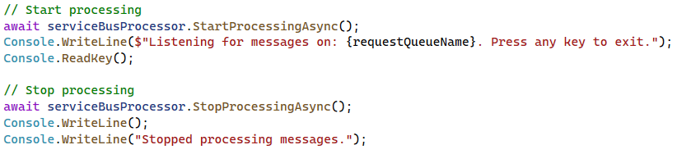
Demonstration
Create Namespace
Create the Request Queue
Create the Response Queue
Create the Requestor
Create the Responder

Slide 60
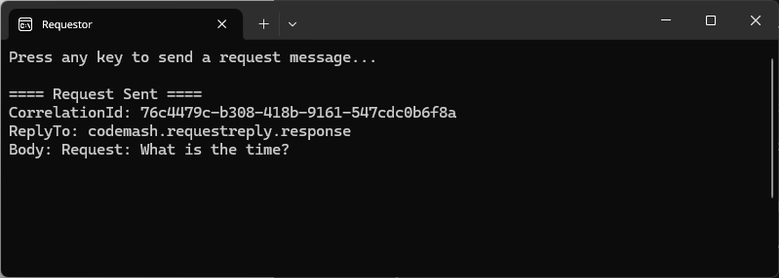
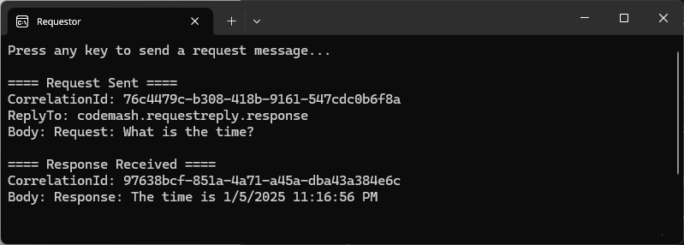
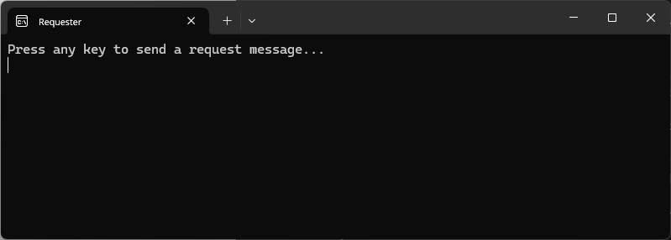
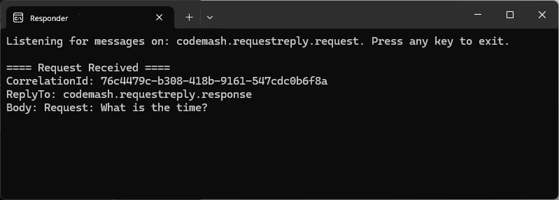
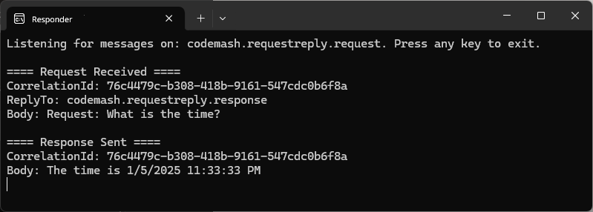
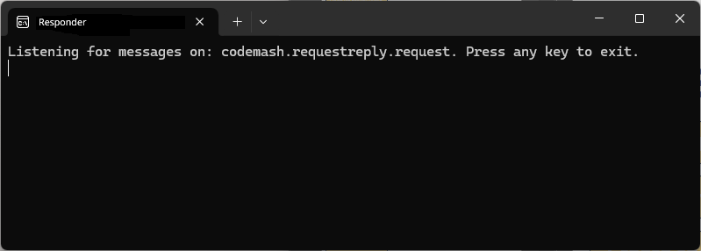
Demonstration
Create Namespace
Create the Request Queue
Create the Response Queue
Create the Requestor
Create the Responder
Run the Demo

Slide 61
Key Points to Remember
Supports two-way communication between services or components.
Suitable for scenarios requiring a response or confirmation
Simplifies synchronous interactions and workflows.

Slide 62
Core Messaging Patterns
Wrap-Up

Slide 63
Importance in Building Robust Cloud Applications
Reliability
Reliability
Scalability
Scalability
Decoupling
Decoupling
Fault Tolerance
Fault Tolerance
Flexibility
Flexibility
Notes:
Reliability: Ensuring messages are delivered and processed as intended.
Scalability: Distributing workload efficiently across multiple consumers and systems.
Decoupling: Allowing different parts of the application to operate independently.
Fault Tolerance: Managing and recovering from failures to maintain system stability.
Flexibility: Enabling a variety of communication models to suit different use cases.

Slide 64
When to Use One Over the Others
Point-to-Point
Competing Consumers
Publish / Subscribe
Request / Replay

Slide 65
When to Use One Over the Others
Point-to-Point
Competing Consumers
Publish / Subscribe
Request / Replay
Notes:
Competing Consumers Messaging
Multiple consumers processing messages from the same queue, improving system scalability and load balancing.
When to Use
When you need to distribute the processing load among multiple consumers to improve efficiency.
Ideal for scenarios with high message throughput where parallel processing is necessary, such as processing orders or jobs.

Slide 66
When to Use One Over the Others
Point-to-Point
Publish / Subscribe
Request / Replay
Notes:
FOR TRANSITION ONLY

Slide 67
When to Use One Over the Others
Point-to-Point
Publish / Subscribe
Request / Replay
Notes:
Talk about patterns sending messages from one place to another

Slide 68
When to Use One Over the Others
Point-to-Point
Publish / Subscribe
Request / Replay
Notes:
Point-to-Point Messaging
Direct communication between a sender and a receiver, ensuring messages are processed by one consumer.
When to Use
When you need reliable, one-to-one communication between two components.
Ideal for scenarios where each message much be processed by only one receiver, such as task distribution.

Slide 69
When to Use One Over the Others
Point-to-Point
Publish / Subscribe
Request / Replay
Notes:
Publish/Subscribe Messaging
Broadcasting messages to multiple subscribers, allowing one-to-many communication.
When to Use
When you need to broadcast messages to multiple receivers.
Suitable for scenarios where multiple subscribes need to receive and act on the same message, such as notifications or event broadcasting.

Slide 70
When to Use One Over the Others
Point-to-Point
Publish / Subscribe
Request / Replay
Notes:
Request/Reply Messaging
Two-way communication where the sender expects a response, facilitating synchronous interactions.
When to Use
When you need synchronous communication with immediate feedback.
Useful for scenarios where a response is required for each request, such as querying a service or performing an action that needs acknowledgement.

Slide 71
Preview of What’s Next in the Workshop
Routing and Processing
Advanced Processing Techniques
Resilience and Reliability
Streaming and Integrations
Design Considerations
Hands-On Exercises
Notes:
Routing and Processing: Enhancing message handling and processing efficiency.
Advanced Processing Techniques: Implementing sophisticated techniques for robust messaging.
Resilience and Reliability: Ensuring fault tolerance, resilience, and reliability in messaging.
Streaming and Integration: Leveraging continuous data streams and integrating systems effectively.
Design Considerations: Understanding best practices for designing resilient messaging systems.
Hands-On Exercises: Practical implementations of advanced patterns to reinforce learning.

Slide 72
Preview of What’s Next in the Workshop
Routing and Processing
Message Routing
Dead Letter Queues
Message Filtering
Aggregator
Scatter-Gather
Notes:
We have covered a lot of ground in the Fundamentals of Messaging module, giving you a solid foundation in core messaging patterns. Before we conclude this section, let’s take a moment to preview what is coming next in our workshop.
In the Routing and Processing module, we will go deeper into more advanced patterns that enhance message handling and processing efficiency. Here is a sneak peek of what we will explore:
Message Routing: Learn how to direct messages to appropriate endpoints for processing.
Dead Letter Queues: Understand the strategies for handling undeliverable messages.
Message Filtering: Discover techniques to process only the messages that matter to your application.
Aggregator Pattern: See how to combine multiple related messages into a single message.
Scatter-Gather: Explore the methods for splitting a message into sub-messages and reassembling the responses.
These patterns will build on what you have already learned and provide you with powerful tools to design robust and efficient messaging solutions. Stay tuned as we continue to enhance your messaging toolkit.

